Slide 1
Water and Electrolyte Balance

Slide 2
Quiz Question #1
Which organ is primarily responsible for controlling sodium release and retention?
Small Intestine
Large Intestine
Kidneys
Liver
Notes:
C

Slide 3
Quiz Question #2
What is the primary physiological response to hypernatremia
Increased water retention
Decreased salt retention
Decreased vasoconstriction
Increased thirst
Notes:
D

Slide 4
Concept Inventory Revisited

Slide 5
Objectives
Understand the function of water in our body
Recognize the kidney as a key regulator in water distribution and balance
Understand how water balance is achieved in our body
Identify the three main electrolytes in our diet and body
Understand how electrolytes balance is achieved in our body
Recognize causes and physiological consequences of water and electrolyte imbalance
Describe recommended intakes for balance water and electrolyte levels in our body

Slide 6
Water Distribution
Water accounts for about 60% total body weight (about 42 L)
Two compartments:
Intracellular – 28 L
Muscle -75% water
Adipose -10% water
Extracellular – 14 L
Interstitial fluid plasma, saliva
Notes:
Optimal activity of cell
Most abundatnt constituent of human body
Women higher fat percentage than men and obese individuals

Slide 7
Water Purposes
Passage way for many nutrients
Blood is 90% water
Urine – rids wastes, excess water/nutrients
Provides protection
Metabolic reactions
Hydrolysis – addition of water
Condensation – loss of water
Regulation of body temperature - water holds heat
Sweat in heated conditions
Constrict blood vessels in colder conditions
pH balance – substances dissolved in water can influence acid-base levels
Solvent – medium in which substances dissolve
Notes:
Despite all of the nutriten metabolism occuring , lubricant– saliva (Dig tract, amniotic fluid pregnancy)
Reactions that occur in the body are very senstive to pH levels
Circulatory, respiratory, renal
Participates in chemical reactions
Lubricant and proetction think of eyes, we tear up to wash away dirt or something foreigh, water iside spinal cord acts as cushion, just from as simple as walking.

Slide 8
Water Transport
Osmosis
Water moves from low solute concentration to high solute concentrations via permeable membranes
Membranes are not normally permeable to water
Creation of water and solute equilibrium across intra- and extracellular spaces
Notes:
Permeable membrane like a cell membrane will allow water to pass freely but not other sbustances , so water moves freely to equalize concentrations of solutes on both sides
Osmotic pressure – amount of pressure to block this flow
Sugar covered strawberry. The water inside the strawberry will dilute out to the high solute conctration on surface of strawberry

Slide 9
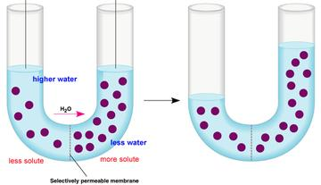
Osmosis Happens Prior to Ion Transport
H₂0
MORE SOLUTE
LESS SOLUTE
LOWER WATER
HIGHER WATER
SOLUTE EQUILIBRIUM
PERMEABLE MEMBRANE
Notes:
Permeable membrane like a cell membrane will allow water to pass freely but not other sbustances , so water moves freely to equalize concentrations of solutes on both sides
Osmotic pressure – amount of pressure to block this flow
Sugar covered strawberry. The water inside the strawberry will dilute out to the high solute conctration on surface of strawberry

Slide 10
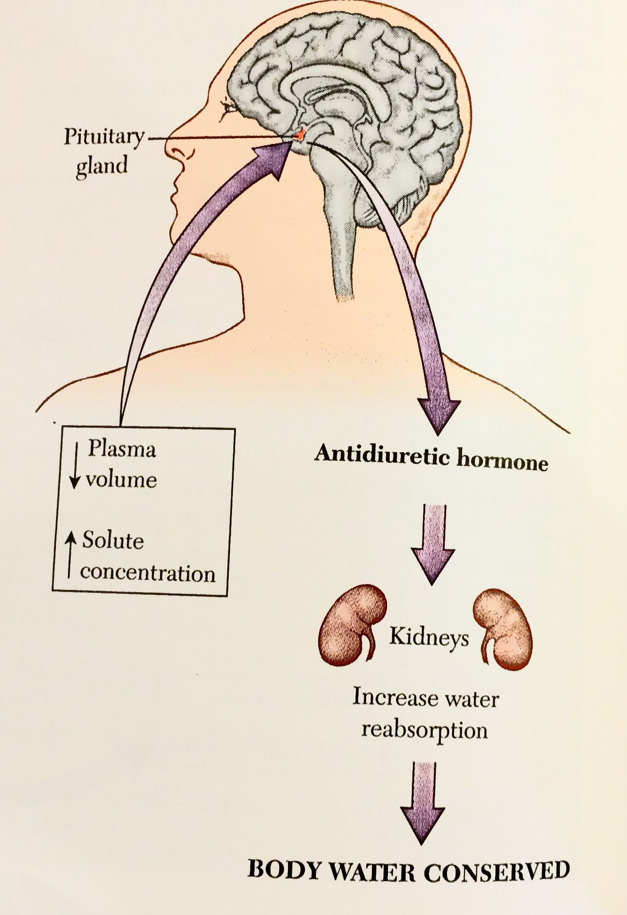
Water Balance Regulation
Kidney – key regulator in water balance
Filtering system - urine production
Filter blood of excess compounds – water, ions, toxins, amino acids, metabolic wastes
Reabsorption of water
Triggered by antidiuretic hormone (ADH aka vasopressin)
ADH released from pituitary gland if high solute concentration in blood
Notes:
Some are reabsorbed, others ecreted via urine
Volume/distribution of fluids and compounds
nitrogenous wastes
ADH is

Slide 11
Volume, Osmolality and Vasopressin
Vasopressin is released due to decreased blood volume or increased salt concentration
Decreased blood volume is detected by mechanoreceptors at the carotid sinus
Increased salt concentration is detected by osmoreceptors in the SFO and hypothalamus
In either case, the hormone dilutes the blood by retaining water.
Also promotes thirst

Slide 12
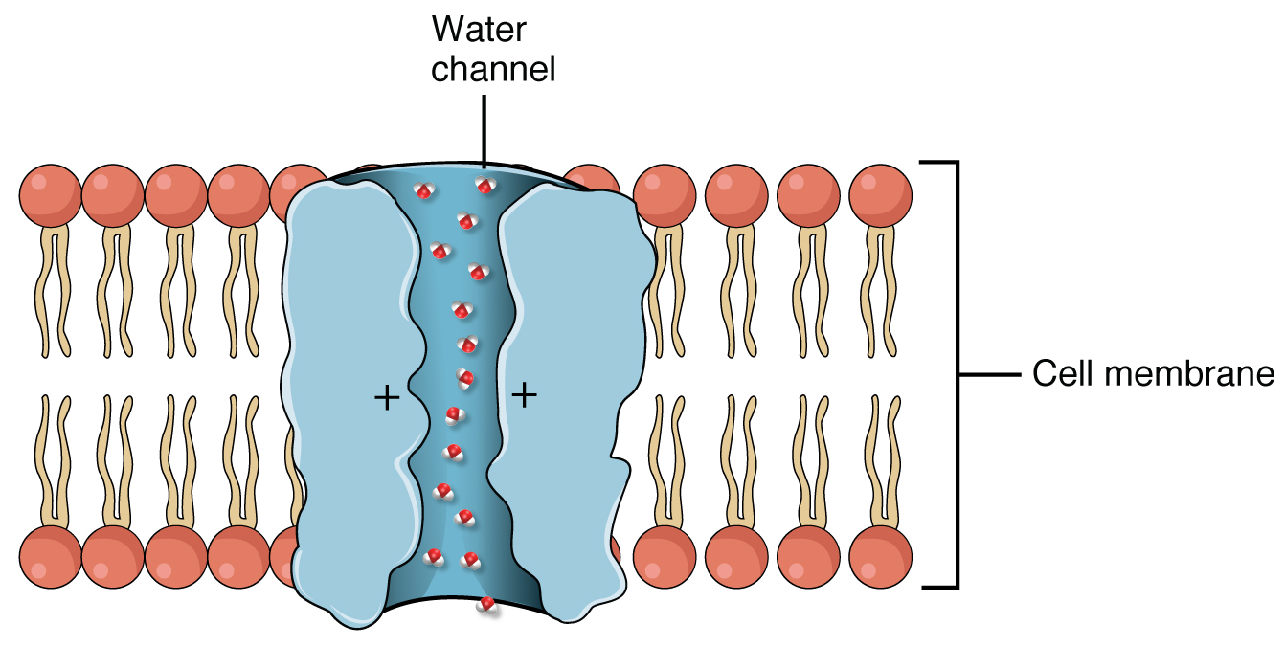
Vasopressin Regulates Aquaporin Trafficking

Slide 13
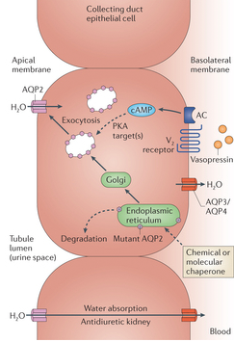
Effects of Vasopressin on the Kidney
Collecting
Tubules
Blood
Water is retained back into the blood, not released as urine
Notes:
Ask if water can normally cross the collecting duct membrane
Why does water travel this way and not that way

Slide 14
Whats another channel that is translocated in response to a hormone like this?
GLUT1
GLUT4
SGLT1
KCNQ

Slide 15
What would the role of osmosis be in water retention?
Water will flow from the urine back to the blood because osmolytes are higher in blood
Water will flow from the blood to urine because osmolytes are higher in blood
Water will flow from the urine back to the blood because osmolytes are higher in urine
Water will flow from blood to urine because osmolytes are higher in urine
Notes:
B

Slide 16
Dehydration
Blood volume decreases, salt concentration increases
Reduction of waste excretion (urine)
1-2% body weight lost as H₂0: headache, fatigue, dry mouth and eyes
5-7% body weight lost as H₂0: Nausea, confusion, disorientation, muscle spasms
>10%: death – blood volume too low for normal circulation, renal failure

Slide 17
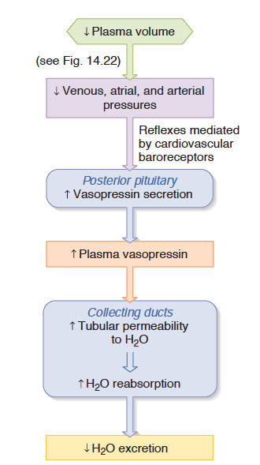
In dehydration how would ADH be affected?
More ADH secretion due to less baroreceptor sensation
More ADH secretion due to more baroreceptor sensation
Less ADH secretion due to less baroreceptor sensation
Less ADH secretion due to more baroreceptor sensation
Notes:
A

Slide 18
Water Imbalance
Over-hydration
Affects distribution of water intra- and extracellularly
High water intake after excessive sweating or during illness
Disrupts solute concentrations
Symptoms similar to dehydration: nausea, muscle cramps, disorientation
Excessive sweating – water intake alone
Recommended to take in water with salt for exercise over an hour

Slide 19
Water Recommendations
Dietary sources – beverages and food
Accounts for most of daily water (> 90%)
Water can be biosynthesized
Product of metabolic reactions
Require intake of about 2.5-3.5L per day to make up for losses
Arginase
Arginine
Urea + H₂0
Ornithine

Slide 20
Electrolytes

Slide 21
Electrolytes
Anions and cations distributed throughout fluid compartments of the body
Sodium (Na⁺)
Potassium (K⁺)
Chloride (Cl⁻)
Functions in body:
Roles in nerve conduction and muscle contraction
Rely on Na/K-ATPase pump
Regulate water balance
Regulate blood pressure
Notes:
Solutes that we will focus on today are electrolytes

Slide 22
Sodium Balance Regulation
Regulatory actions by renin-angiotensin-aldosterone system (RAAS)
Role in Na balance (as well water)
Maintains blood pressure
Responds to low blood pressure
Low blood volume (low sodium and water concentrations extracellularly)

Slide 23
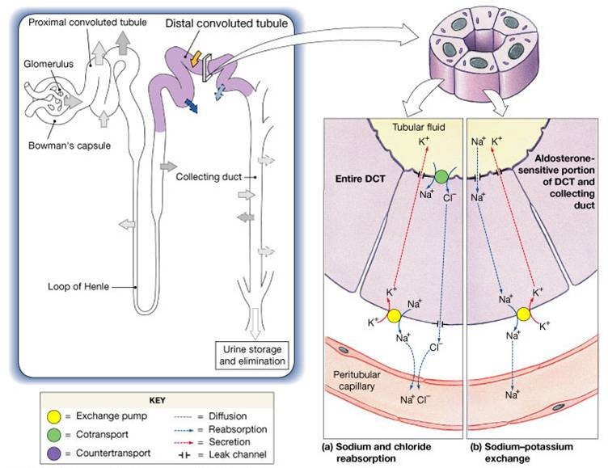
Aldosterone Activates Salt Re-Uptake
ENac
Na/K
ATPase
Notes:
ENac

Slide 24
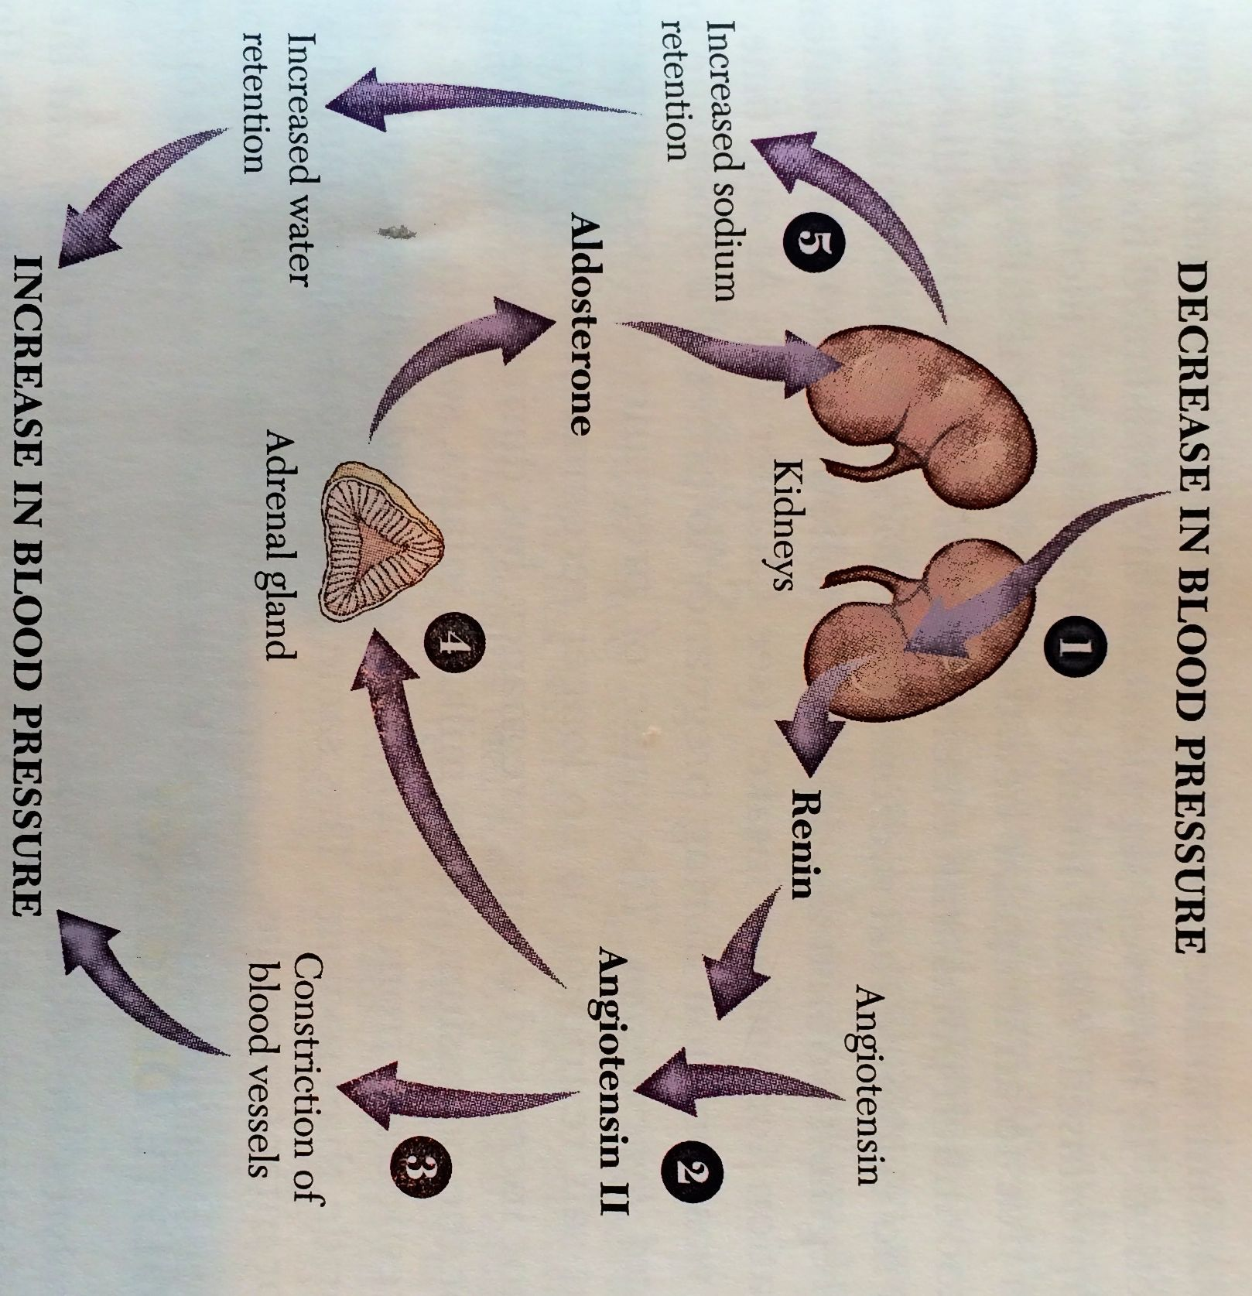
Aldosterone is Regulated by the Renin-Angiotensin System
Notes:
Asian poplulation up to 14 g/day
Indigenous populaitoins in brazil <.1g/day
Cl excreted in urine in similar concentrations to sodioum

Slide 25
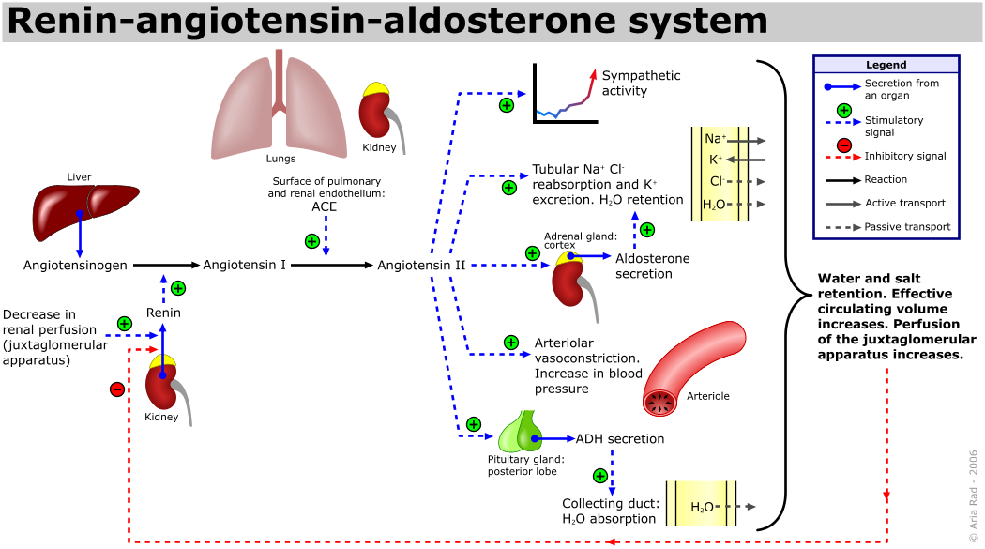
The Renin/Angiotensin System
Notes:
Point out the negative feedback occurs via sensing at the JG cell.
Quick effect via angiotensin, long term effect via aldosterone
Less stretch, less
This is separate to just the effects of vasopressin

Slide 26
Renin/Angiotensin System
Kidneys release renin in response to decrease in pressure in kidneys
Renin stimulates angiotensin II (from liver)
Angiotensin II stimulates release of aldosterone (from adrenal gland)
Also constricts blood vessels
Aldosterone stimulates reabsorption of sodium
Highly selective for sodium, little water diffusion
ADH stimulates majority of water reabsorption
Blood pressure increases
Notes:
Asian poplulation up to 14 g/day
Indigenous populaitoins in brazil <.1g/day
Cl excreted in urine in similar concentrations to sodioum
Water should follow, but only a little diffuses, this is when ADH kicks in.

Slide 27
Potassium Balance

Slide 28
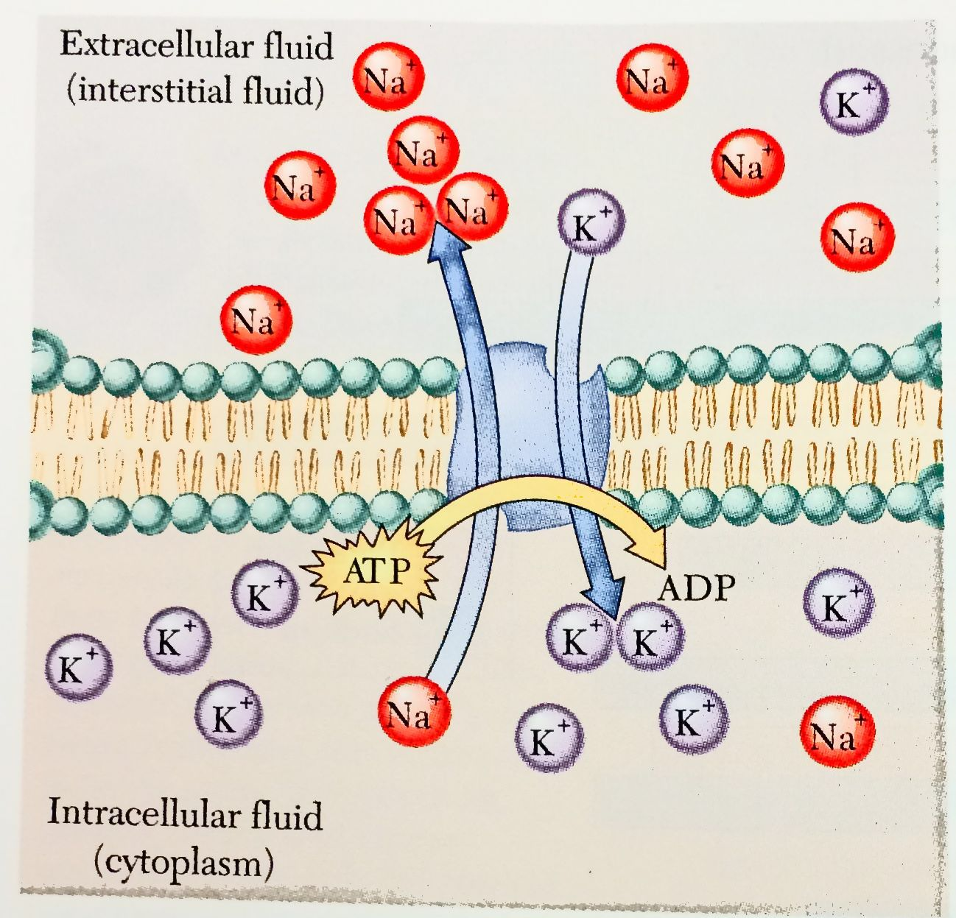
Electrolyte (Na and K) Balance Regulation
Na⁺ concentrations
high extracellularly
K⁺ concentrations
high intracellularly
Notes:
Some can leak across Uses ATP to keep the na concentrations high out of the cell and K high inside the cell – important implications in contraction and nerve conduction, nutrient transport system like glucose at the apical membrane of the enterocyte
Means of diffusion of Sugars and amino acidsacross cell membranes!!!
Solute concentrations effect osmosisDistribution of water responds to soluteelectrolyte concentrations

Slide 29
Electrolyte (K⁺) Balance Regulation
High Intracellularly, so naturally elevated in many foods
We excrete 90% of potassium
Mostly excreted in co-ordinate with sodium retention
How would a high potassium diet affect sodium retention?
Notes:
Works similarly to NaK Atpase pump

Slide 30
Electrolyte Imbalances

Slide 31
Impairments in Electrolyte Balance
Nerve conduction and muscle contraction
Stimuli (taste, touch) changes cell membrane’s permeability
Allows sodium ions to enter cell
Change in electrical charge across cell membranes
Electrical current generated
Nerve impulse or muscle contraction passes and Na/K-ATPase pump returns cellular charge to original state
Notes:
Some can leak across. WHAT ARE THE STIMULI???
Nerve impluse travels along nerve cell as an electrical current
resting states negative charge

Slide 32
Electrolyte Imbalance
Deficiencies due to:
Heavy, persistent sweating
Chronic diarrhea, vomiting
Kidney disorders
Toxicity
Excreted via urine in healthy individuals, balanced by water intake
“Salt-sensitive” individuals – unable to balance sodium = hypertension
Notes:
Obesity= excess AT increases capilleries in which blood has to flow
Age = arteries lose elasticity
African americans = 4.2 times greater rate of kidney failure than caucasions

Slide 33
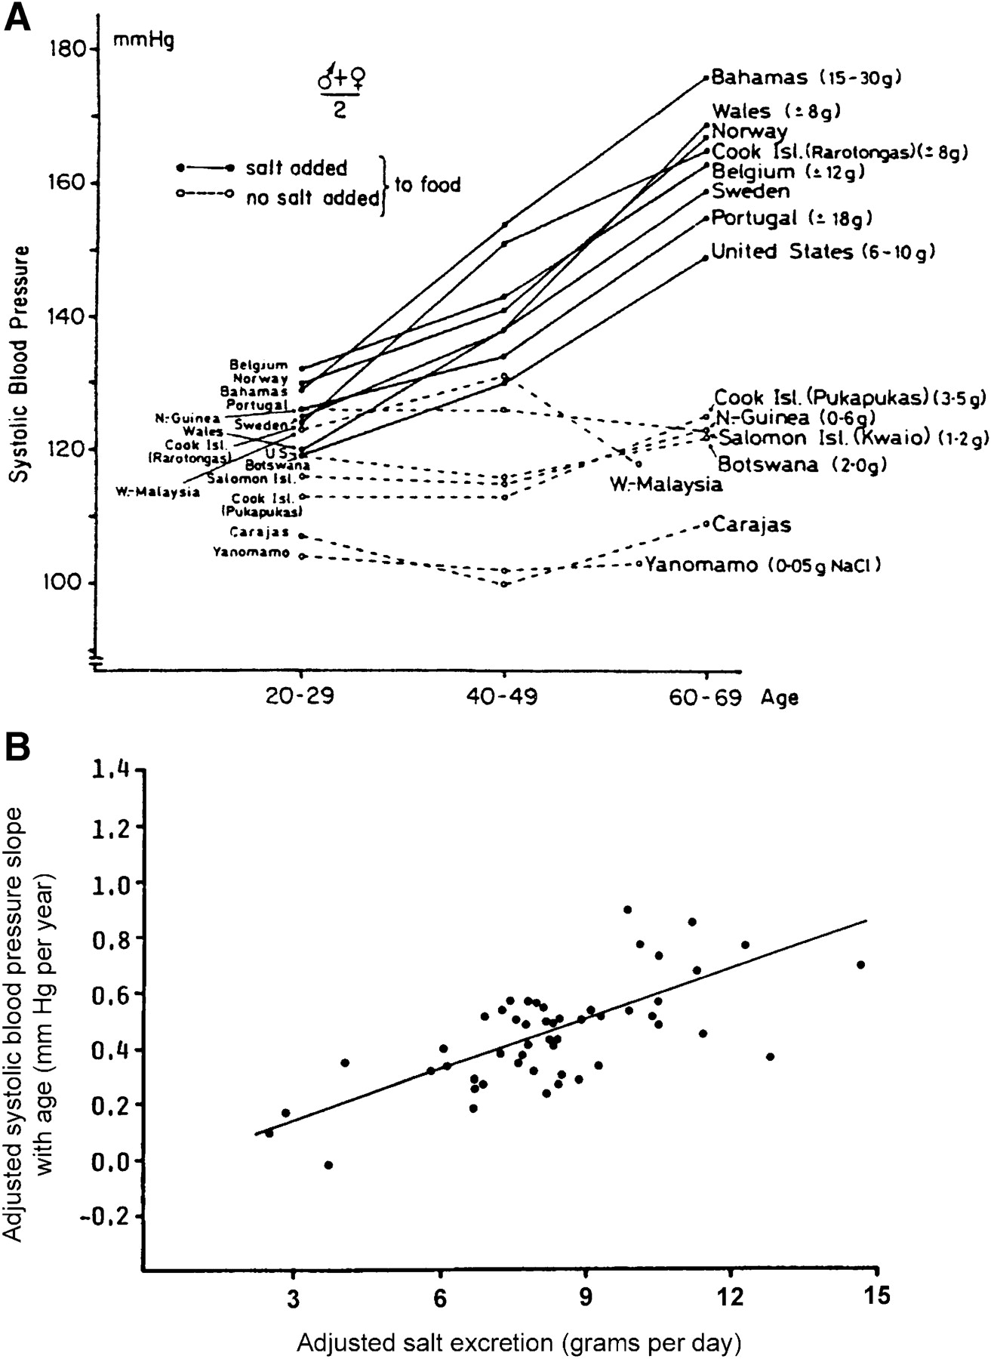
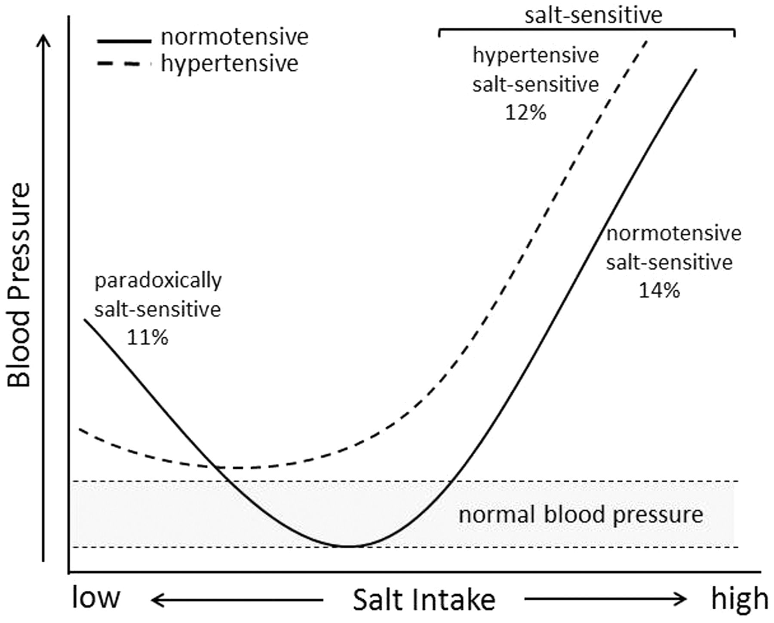
Salt Intake and Hypertension
Variations of salt (NaCl) intake across populations
Notes:
Asian poplulation up to 14 g/day
Indigenous populaitoins in brazil <.1g/day
Chloride concentrations among compartments in particularly extraculluar parallel that of sodium

Slide 34
Na and Cl Recommendations
Sodium intake is accompanied by chloride intake
Sodium: <2400 mg/day
Chloride: 2300 mg/day
Equivalent to 3.8 g salt/day
Upper limit set at 6 g salt/day – based on adverse affects of blood pressure
Individuals with hypertension (high blood pressure): <1500 mg sodium/day

Slide 35
What happens at very low salt intake?

Slide 36
K Recommendations
Potassium
Adequate intake: 4700 mg/day
Level indicated to help reduce adverse effects of sodium on blood pressure
No upper limit set for individuals with normal functioning kidneys

Slide 37
Summary Exercise
In your groups think about what happens when you overhydrate with water
What happens to ADH
water transport
What happens to Renin, Angiotensin and Aldosterone
Salt transport

Slide 38
Summary
Water has many important roles in our body
Solvent – helps maintain electrolyte concentrations intra- and extracellularly
ADH is a key hormone in regulating water balance
RAAS helps maintain Na (and water) balance
Involves kidney, enzymes, hormones, and brain
Main electrolytes in our diet and body are Na, Cl, and K
Balance of electrolytes is achieved by kidney reabsorption, hormonal regulation and urine production
Water and electrolyte deficiencies and toxicities can occur
Excessive sweating, illness

